Slide 1

Chapter 12
Unleashing JavaScript Using JQuery

Slide 2
Learning Objectives
How to download the JQuery library.
How to integrate the JQuery library into an HTML page.
How to use JQuery to fade an element out or into a page.
How to use JQuery to show or hide an element.
How to use JQuery to slide a page division.
How to use JQuery to animate an object.
How to use JQuery to access HTML or CSS elements within a page.

Slide 3
jquery
JQuery is a library of routines your pages can call using JavaScript. Instead, you access it much like an external JavaScript file.
Developers often download the JQuery library from JQuery.com web site.
After they download the JQuery library file, the developers then place a copy of the file into the folder that contains a page’s HTML files. Then, they link to the file within their page using a statement such as:
<script src="jquery.js"></script>

Slide 4
Jquery syntax
To use JQuery, you generally specify an element on your page and the operation you want to perform on the element. The general JQuery syntax is:
$(elementSelector).action();
The elementSelector corresponds to a selector you would use with CSS. Consider the following examples:
$(this).fadeOut(); // fades out the current element $(“div”).fadeOut(); // fades out all div elements $(“.classname”).fadeOut(); // fades out elements that use the specified CSS class $(“#elementID”).fadeOut(); // fades out the element with the id elementID

Slide 5
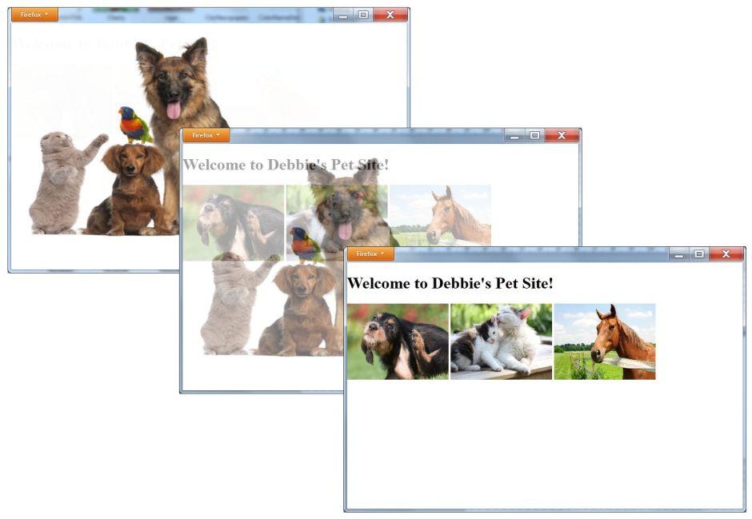
Using jquery to fade an image
<!DOCTYPE html> <html> <head> <script src="http://www.websitedevelopmentbook.com/chapter12/jquery.js"></script> <script> function HideImage() { $("#Pets").fadeOut(8000); } </script> </head> <body onload="HideImage()"> <img id="Pets" src="http://www.websitedevelopmentbook.com/chapter12/Pets.jpg" style="position:absolute; top:0px; left:0px; z-index:1;" width="650px" height="425px"/> <div id="PageContent" style="position:absolute;top:0px;left:0px"> <h1>Welcome to Debbie's Pet Site!</h1> <img src="http://www.websitedevelopmentbook.com/chapter12/dog.jpg" width="200px" height="150px" /> <img src="http://www.websitedevelopmentbook.com/chapter12/cat.jpg" width="200px" height="150px" /> <img src="http://www.websitedevelopmentbook.com/chapter12/horse.jpg" width="200px" height="150px" /> </div> </body> </html>

Slide 6
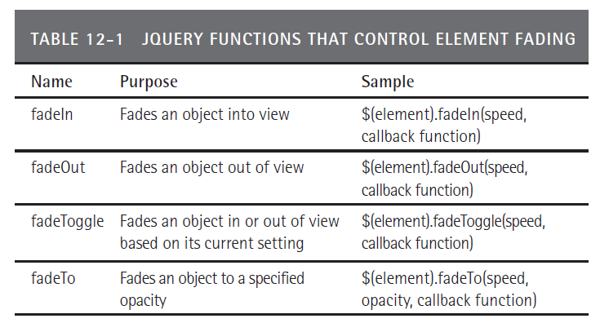
Fading elements

Slide 7
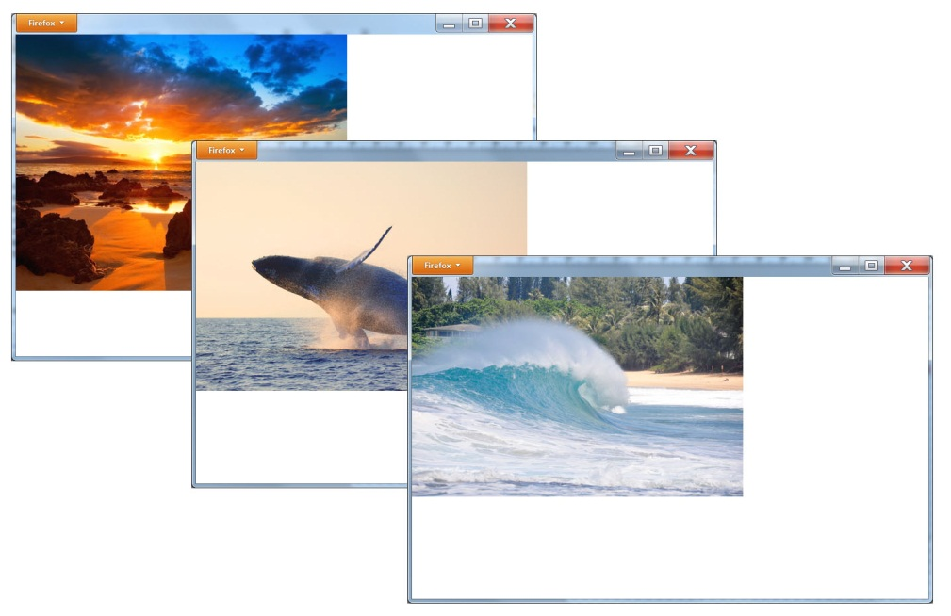
Jquery slideshow
<!DOCTYPE html> <html> <head> <script src="http://www.websitedevelopmentbook.com/chapter12/jquery.js"></script> <script> function FadeImage(I) { var Image = '#'+I; $(Image).fadeIn(); $(Image).fadeOut(5000, function() { FadeImage((I == 1) ? 3: I-1); }); } </script> </head> <body onload="FadeImage(3);"> <img id="1" src="http://www.websitedevelopmentbook.com/chapter12/maui01.jpg" style="position:absolute; left:0; top:0; z-index:1;" /> <img id="2" src="http://www.websitedevelopmentbook.com/chapter12/mau0i2.jpg" style="position:absolute; left:0; top:0; z-index:2;"/> <img id="3" src="http://www.websitedevelopmentbook.com/chapter12/maui03.jpg" style="position:absolute; left:0; top:0; z-index:3;" /> </body> </html>

Slide 8
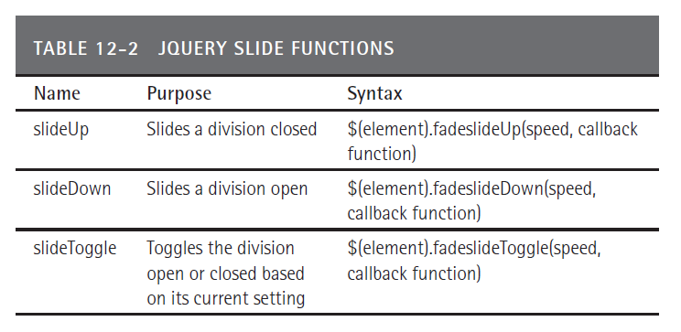
Jquery slide functions

Slide 9
Using slides
<!DOCTYPE html> <html> <head> <script src="http://www.websitedevelopmentbook.com/chapter12/jquery.js"></script> <script> function CloseSlide(Division) { Division = '#'+Division; $(Division).slideUp(); } function OpenSlide(Division) { Division = '#'+Division; $(Division).slideDown(); } </script> </head>

Slide 10
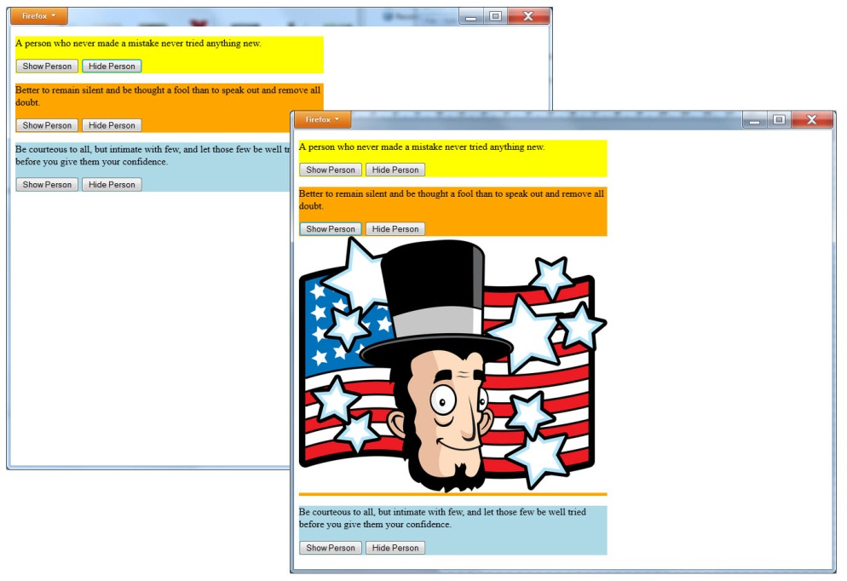
Using slides continued
<body > <div style="background-color:yellow; width:500px; height=500px;" id="1"> <div style="width:500px; height=50px;" id="1a"> <p>A person who never made a mistake never tried anything new.</p> <button onclick="OpenSlide('1b')">Show Person</button> <button onclick="CloseSlide('1b')">Hide Person</button> </div> <div style="width:500px; height=450px;" id="1b" > <img src="einstein.jpg" onload="CloseSlide('1b')"/> </div> </div> <div style="background-color:orange; width:500px; height=500px;" id="2"> <div style="width:500px; height=50px;" id="2a"> <p>Better to remain silent and be thought a fool than to speak out and remove all doubt.</p> <button onclick="OpenSlide('2b')">Show Person</button> <button onclick="CloseSlide('2b')">Hide Person</button> </div> <div style="width:500px; height=450px;" id="2b" > <img src="lincoln.jpg" onload="CloseSlide('2b')"/> </div> </div> <div style="background-color:lightblue; width:500px; height=500px;" id="3"> <div style="width:500px; height=50px;" id="3a"> <p>Be courteous to all, but intimate with few, and let those few be well tried before you give them your confidence.</p> <button onclick="OpenSlide('3b')">Show Person</button> <button onclick="CloseSlide('3b')">Hide Person</button> </div> <div style="width:500px; height=450px;" id="3b" > <img src="washington.jpg" onload="CloseSlide('3b')"/> </div> </div> </body> </html>

Slide 11
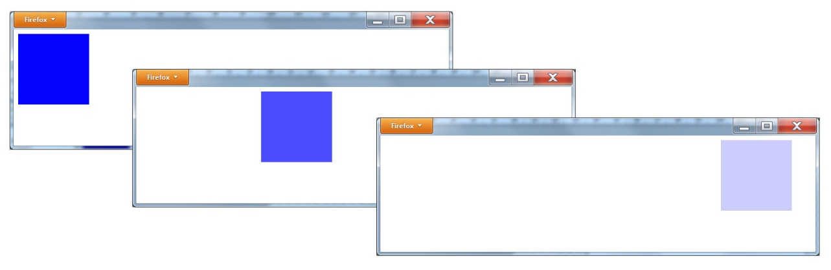
Using jquery to slide a box
<!DOCTYPE html> <html> <head> <script src="http://www.websitedevelopmentbook.com/chapter12/jquery.js"></script> <script> function SlideBox(Division) { Division = '#'+Division; $(Division).animate({ left:'600px', opacity: '0.2' }, 5000); } </script> </head> <body onload="SlideBox('1')"> <div style="width:125px; height:125px; background-color:blue; position:absolute; left:0px" id="1"></div> </body> </html>

Slide 12
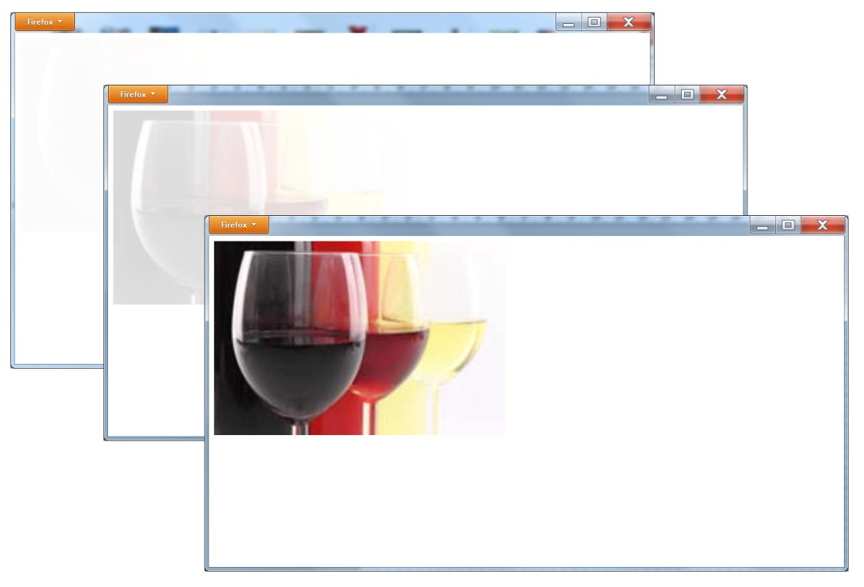
Using a jquery animation to reveal a photo
<!DOCTYPE html> <html> <head> <script src="http://www.websitedevelopmentbook.com/chapter12/jquery.js"></script> <script> function RevealImage(Image) { $(Image).animate({ opacity: '1.0' }, 5000); } </script> </head> <body onload="RevealImage('#1')"> <img id="1" src="wine.jpg" width="450" height="300" style="position:absolute; opacity:0.0;"/> </body> </html>

Slide 13
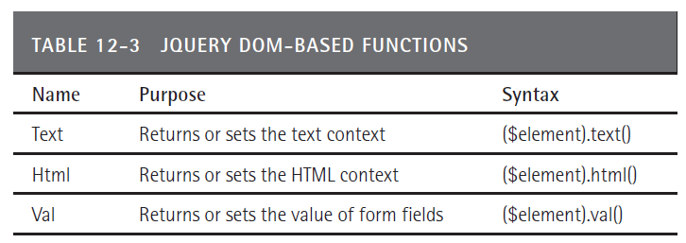
Jquery DOM-Based Functions

Slide 14
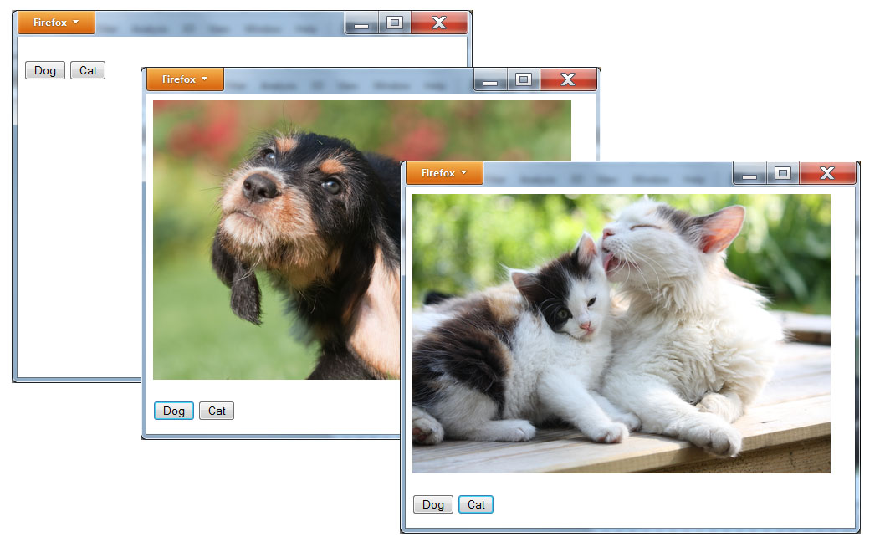
Creating a Div for an image
<!DOCTYPE html> <html> <head> <script src="http://www.websitedevelopmentbook.com/chapter12/jquery.js"></script> <script> function DisplayImage(Pet) { if (Pet == 'Dog') $('#ImageSpace').html('<img src="dog.jpg"/>'); else $('#ImageSpace').html('<img src="cat.jpg"/>'); } </script> </head> <body> <div id="ImageSpace" style="width:1200; height:400"> </div> <br/> <button onclick="DisplayImage('Dog')">Dog</button> <button onclick="DisplayImage('Cat')">Cat</button> </body> </html>

Slide 15
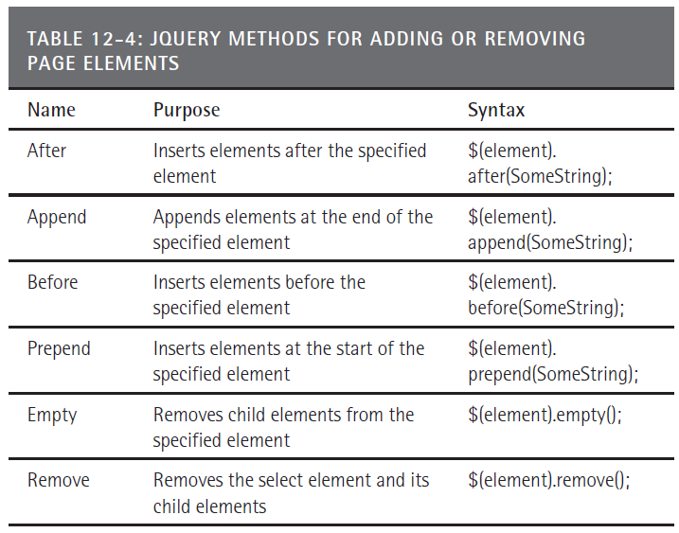
Adding and removing page elements

Slide 16
Adding and removing elements
<!DOCTYPE html> <html> <head> <script src="http://www.websitedevelopmentbook.com/chapter12/jquery.js"></script> <script> var Images = ['<img id="0" src="wine.jpg" width="200" height="150"/>', '<img id="1" src="cigar.jpg" width="200" height="150"/>', '<img id="2" src="pizza.jpg" width="200" height="150"/>', '<img id="3" src="pasta.jpg" width="200" height="150"/>', '<img id="4" src="dessert.jpg" width="200" height="150"/>']; var i = 0; var AddImageTimer; var RemoveImageTimer; function AddImage(Division) { if (i == 0) { AddImageTimer = setInterval(function(){ AddImage(Division) }, 1000); $("button").hide(); } if (i < Images.length) { $(Division).append(Images[i]); i = i + 1; } else { i = i - 1; clearInterval(AddImageTimer); RemoveImage(Division); } }

Slide 17
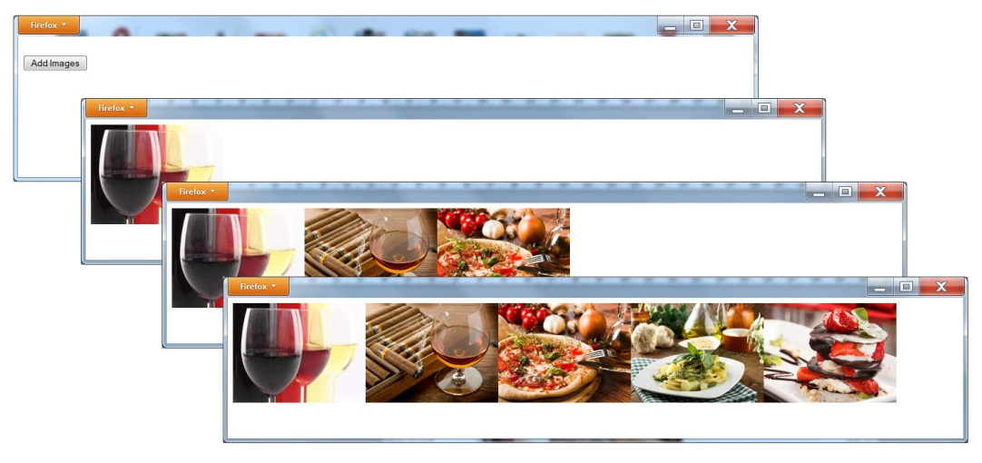
Adding and removing elements continued
function RemoveImage(Division) { if (i == (Images.length-1)) RemoveImageTimer = setInterval(function(){ RemoveImage(Division) }, 1000); if (i >= 0) { ImageId = '#'+i; $(ImageId).remove(); i = i - 1; } else { i = 0; clearInterval(RemoveImageTimer); AddImage(Division); } } </script> </head> <body> <div id="ImageSpace" style="width:1200; height:400"></div><br/> <button onclick="AddImage('#ImageSpace')">Add Images</button></body> </html>

Slide 18
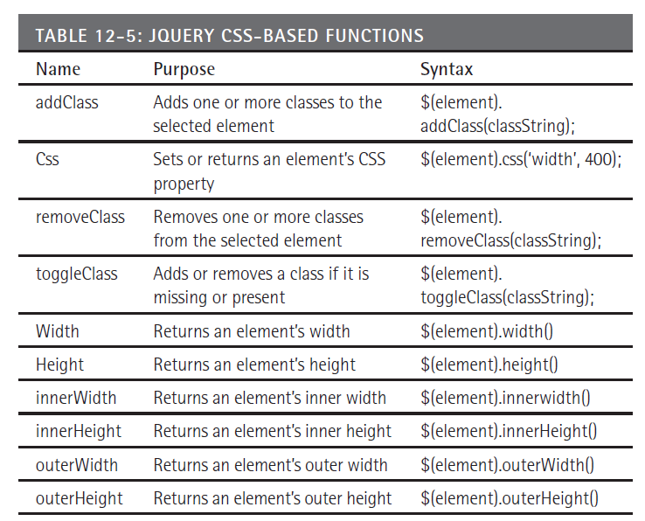
JQUERY and CSS

Slide 19
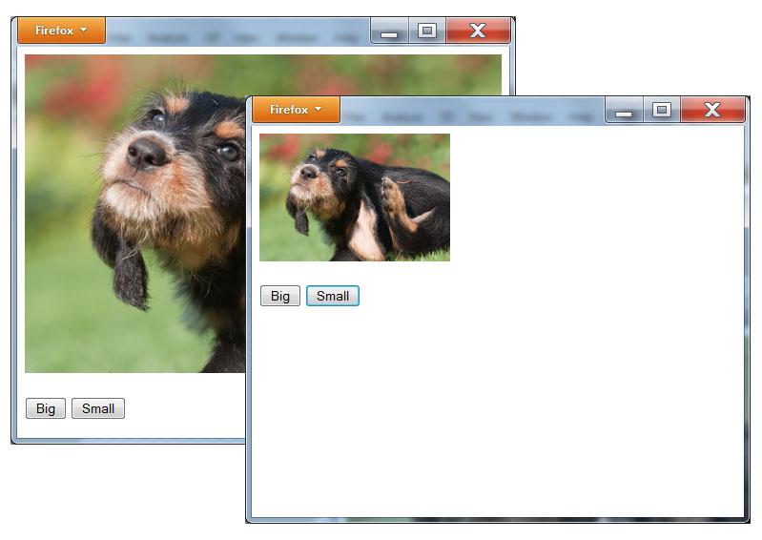
Jquery/CSS Example
<!DOCTYPE html> <html> <head> <script src="http://www.websitedevelopmentbook.com/chapter12/jquery.js"></script> <script> function DisplayImage(Size) { if (Size == 'Big') $('#DogImage').css("width", "400px", "height", "300px"); else $('#DogImage').css("width", "200px", "height", "150px"); } </script> </head> <body> <div style="width:600; height:400"> <img id="DogImage" src="dog.jpg" /> </div> <br/> <button onclick="DisplayImage('Big')">Big</button> <button onclick="DisplayImage('Small')">Small</button> </body> </html>

Slide 20
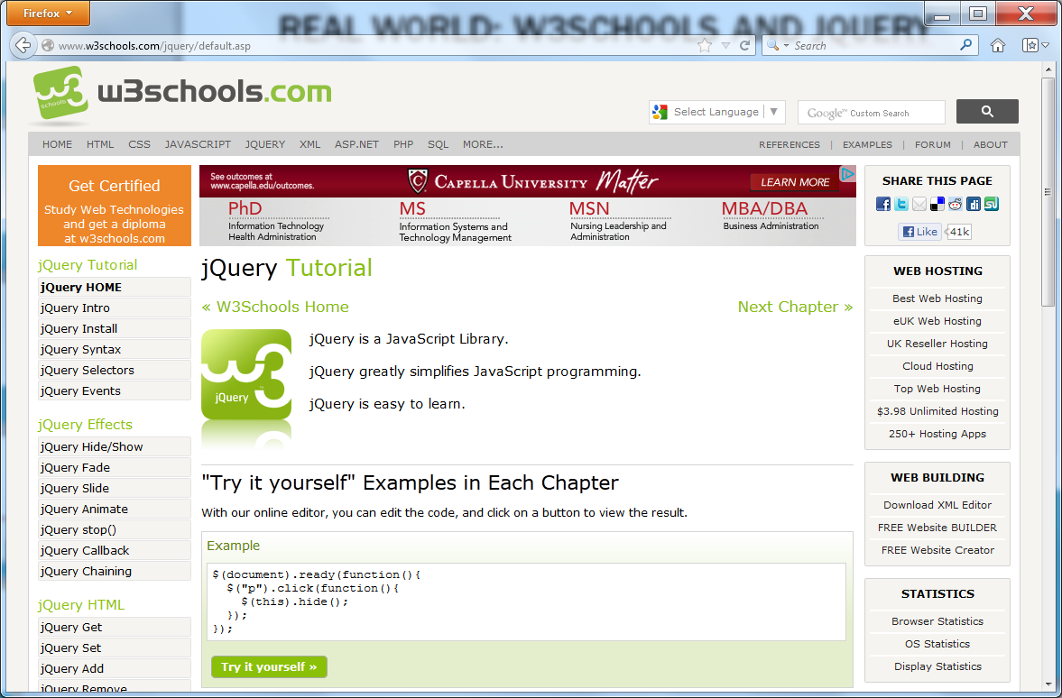
Real world: w3schools and jquery

Slide 21
summary
JQuery provides a library of functions you can use to improve a user’s experience with your Web page.
Using JQuery you can hide or show elements on a page, fade items in or out of view, slide open or closed page divisions, and set or retrieve HTML and CSS elements and attributes.

